Slide 1

TEAM TKT
Zika Hack 2017
Daniel Jumail Karlene Steven Jenny

Slide 2
Aim
To predict the Brazilian Zika Outbreak as soon as possible

Slide 3
Background
Possible signal Nov 2014.
Brazil alert from Nov 2015.
Brazil end alert Nov 2016.

Slide 4
Hypothesis
Google Search Terms in Portuguese and Spanish related to microcephaly and babies can predict Zika outbreaks
A generalized probabilistic model could predict Zika’s recurrence.

Slide 5
Solution
Search Terms
Climatic Data
Secondary Sources
Renewal of Models
Probability Model
Machine Learning Model
Variable Tweaking
Training
Recurrence Probability
Outbreak Confidence
Zika Outbreak Possibility
Data

Slide 6
Programming
Recurrence Probability | Outbreak Confidence
Julia Lang | Python Numpy, Sklearn, TensorFlow, Keras, Pandas, Matplotlib

Slide 7
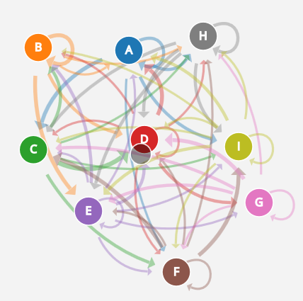
Recurrence Probability
Markov Chains to model spread and
Recurrence behaviour.
Transition matrix is updated very time.
Considered:
Living Standards
Precipitation, Temperature
Density of population
Mass gatherings
SIR model
Mosquito distribution

Slide 8
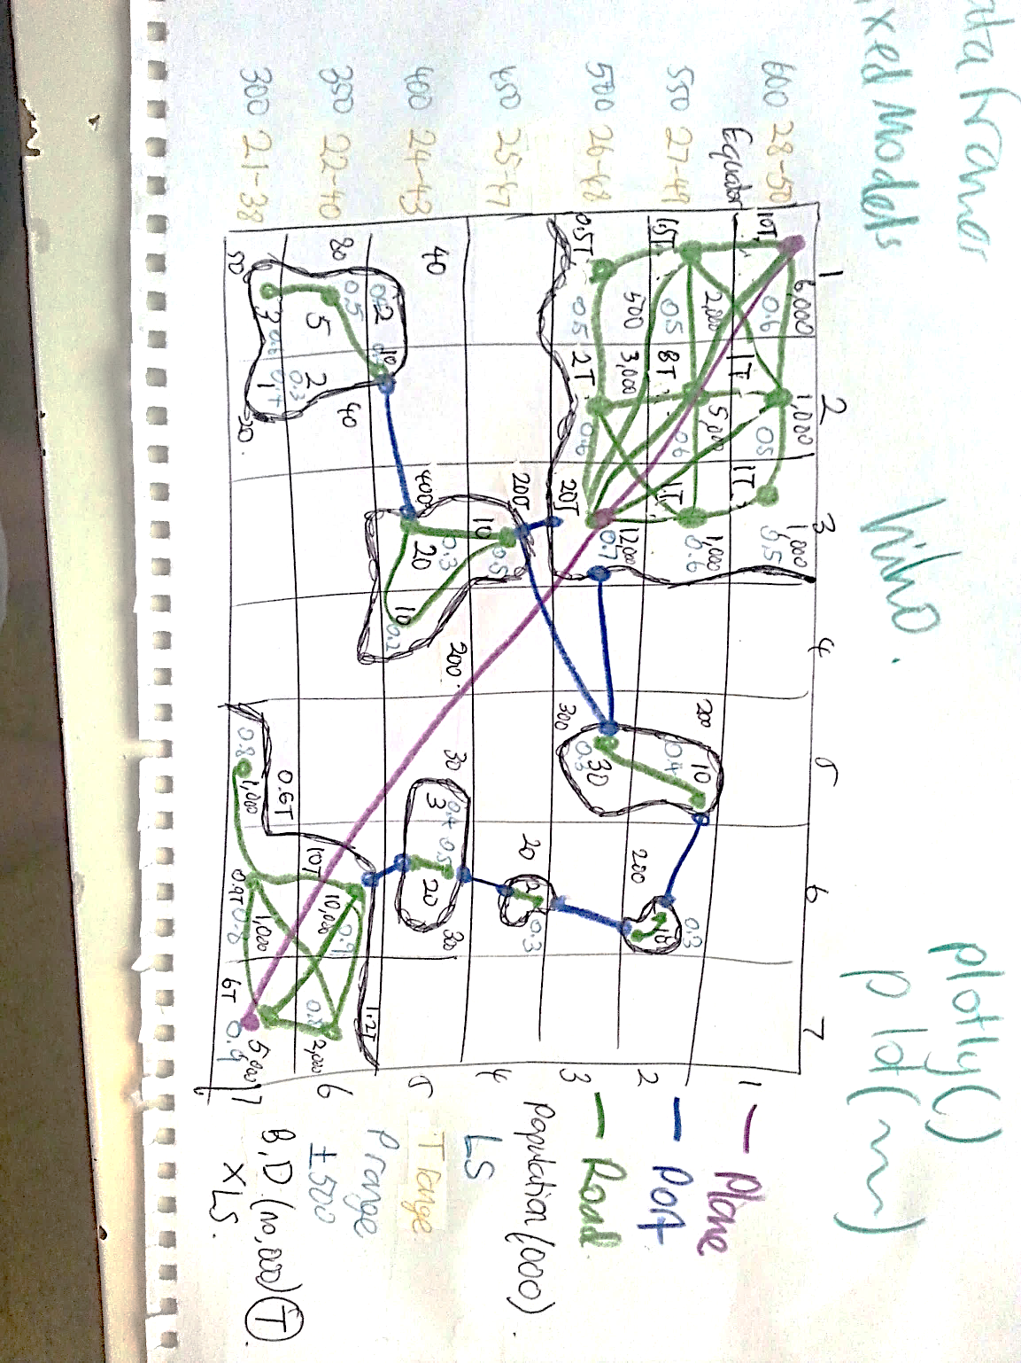
Markov SIR Model

Slide 9
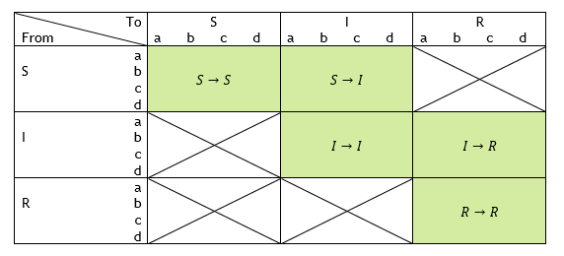
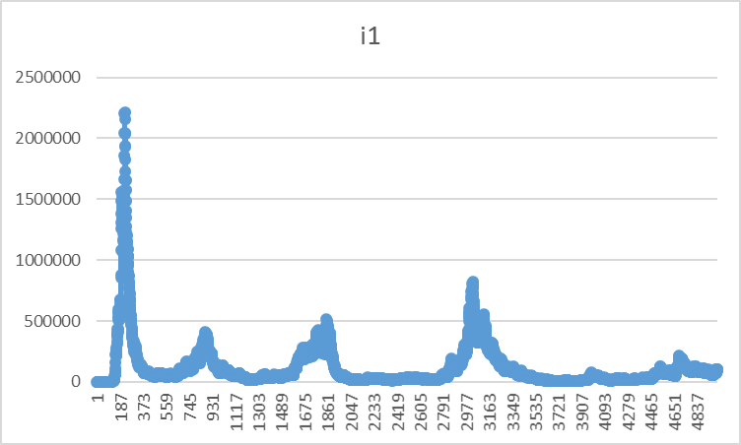
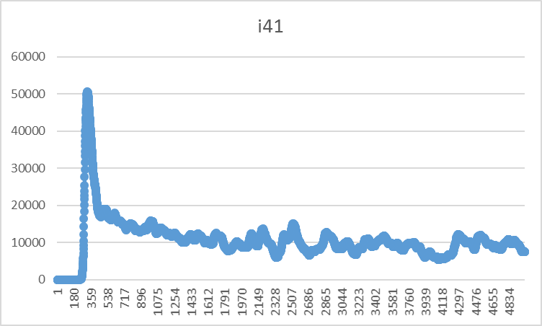
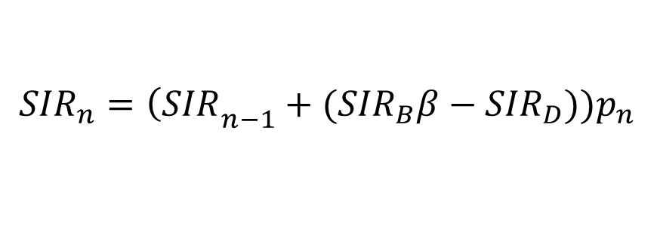
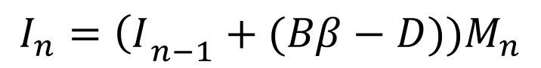
Markov SIR Model
$$I_{n}={\left(I\right.}_{n−1}+(Bβ−D))M_{n}$$
$${SIR}_{n}={\left(SIR\right.}_{n−1}+({SIR}_{B}β−{SIR}_{D}))p_{n}$$

Slide 10
Problems
No easily accessible data

Slide 11
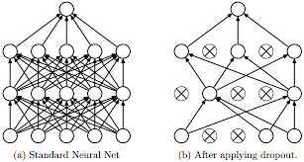
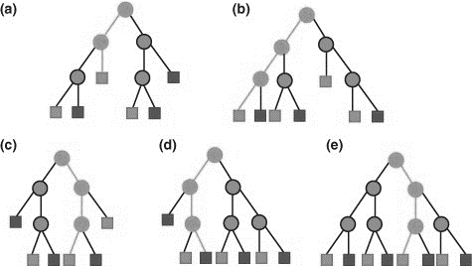
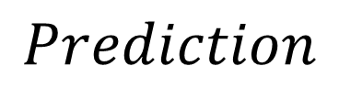
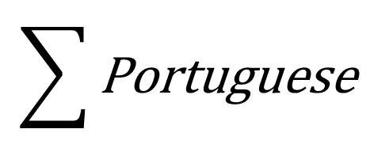
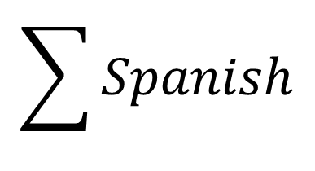
Outbreak Confidence
Spanish Search Terms
Portuguese Search Terms
$$\sum{Spanish}$$
$$\sum{\text{Portuguese}}$$
$$Prediction$$

Slide 12
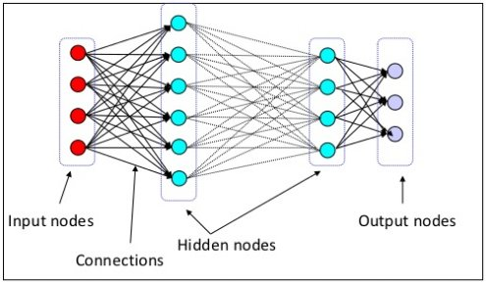
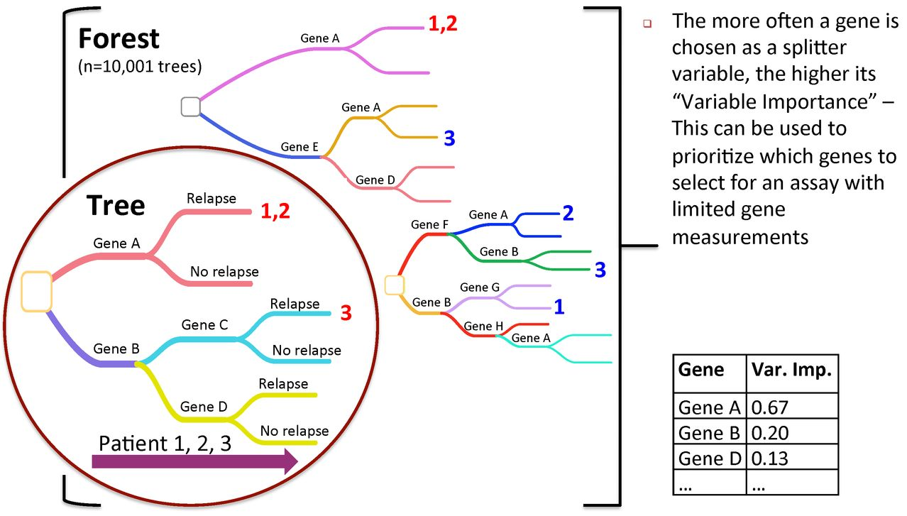
Outbreak Confidence
Deep Learning Random Forests

Slide 13
Outbreak Confidence
Problems
Deep Neural Network: Around 5-6 hidden layers
Ensemble Random Forest: Around 1000-2000 est

Slide 14
Search Terms
Portuguese | Spanish
ultrassom,pequeno,cabeça,trimestre,grávida criança,mãe,Mamãe,bebê,médico babycenter,clínica,anormal,Tamanho,circunferência cérebro,nervo,tumor,sangue,amniótico fluido,nascermos,gravidez,Fralda,Vômito nascimento,hospital,incapacidade,Desativado, crescimento | Ultrasonido,pequeña, cabeza, trimestre, embarazada Niño, madre, mamá, bebé, doctor Babycenter, clínica, anormal, tamaño, circunferencia Cerebro, nervio, tumor, sangre, amniotico Fluido, nacido, embarazo, panal, Vomito Nacimiento, hospital, discapacidad, discapacidad, crecimiento

Slide 15
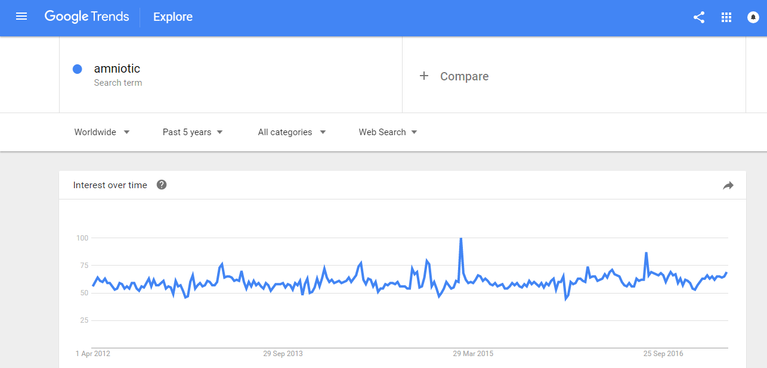
Google Trends

Slide 16
Results

Slide 17
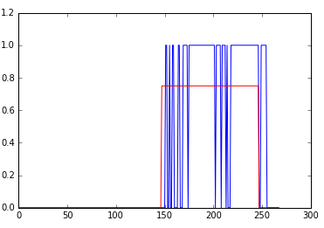
Brazil
Red line is December
2014 (Proposed signal is
November 2014)
End of red line is
November 2016
Prediction: 12/2014

Slide 18
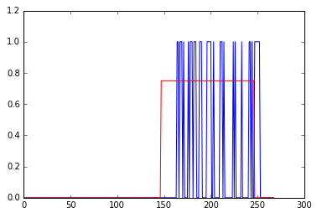
Bahia
Prediction: 2-3/2015

Slide 19
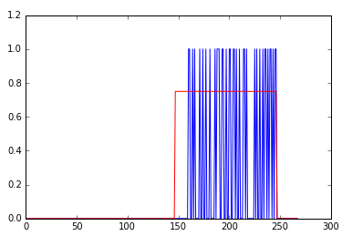
Rio de Norte
Prediction: 2/2015

Slide 20
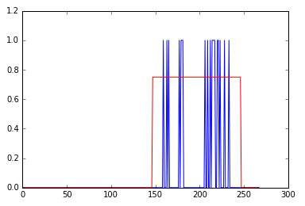
Pernambucano
Prediction: 2/2015

Slide 21
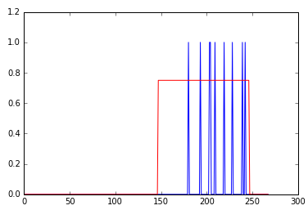
Maranhao
Prediction: 5-6/2015
A bit slow

Slide 22
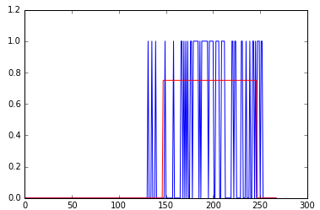
Rio de Jainero
Prediction: 11/2014

Slide 23
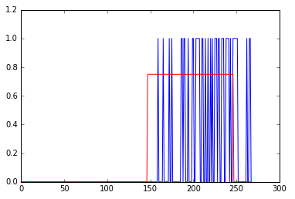
Parana
Prediction: 1-2/2015
If given more data, then
Over prediction is removed
(end epidemic Nov 2016)

Slide 24
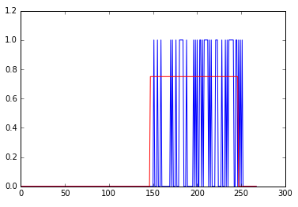
Goias
Prediction: 12-1/2014,15

Slide 25
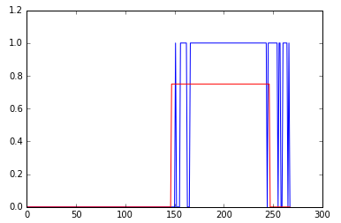
Ceara
Prediction: 12/2014

Slide 26
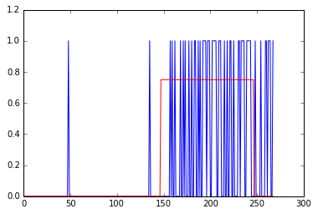
Espírito Santo
Prediction: 10-11/2014
Some false positives
early noise, but only
1 week signal (can ignore
As not continuous trend)

Slide 27
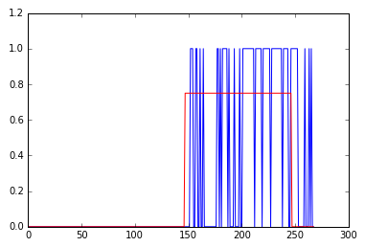
Santa Catarina
Prediction: 12-1/2014, 15

Slide 28
Problems
Some Noise – Extended the trend
Overprediction – Need more data
(Model trained until 1/4/2017)
3. Normalization – not on wide scale (we can’t access it)

Slide 29
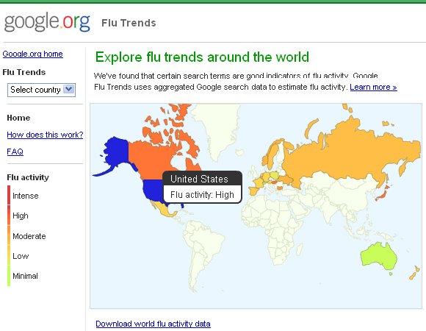
User Interface
Currently just code interface.
Wanted to create a dashboard

Slide 30
Code
Recurrence Prob | Recurrence Prob Julia Code | Outbreak Confidence

